Slide 1

Networks Fundamentals
Mousa Al-Sahory

Slide 2
Layer 3
Chapter 6
Network Layer

Slide 3
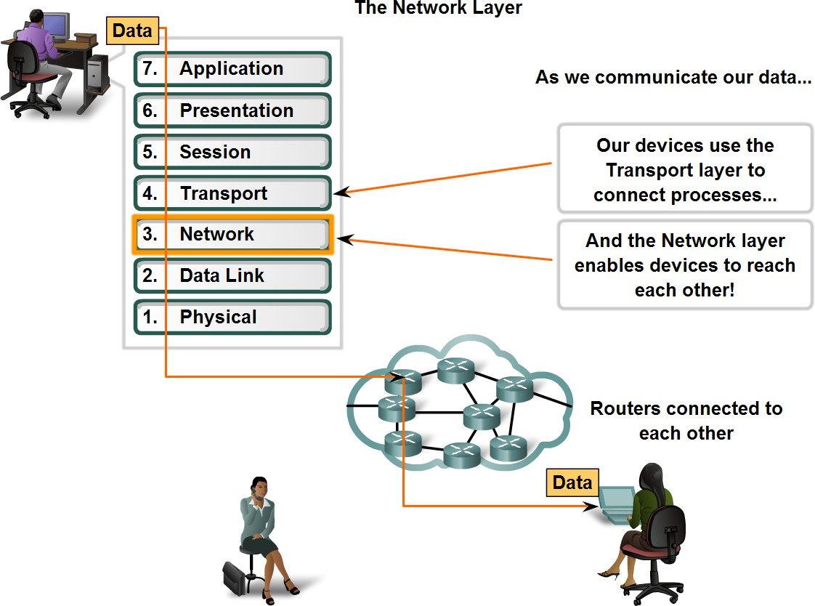
Network Layer Protocols and Internet Protocol (IP)

Slide 4
Network Layer Protocols and Internet Protocol (IP)
Determines the best way to move data.
Responsible for logical addressing (IP addressing)
Routing happens at network layer.
PDU at network layer is (packet).
Fragmentation: It is technique in which gateways break up or divide larger packets into smaller ones called fragments. Each fragment is then sent as a separate internal packet. Each fragment has its separate header and trailer.
Types of packets at network layer:
  Data packets: transport user data. Protocols used are routed protocols such as IP, and IPX.
  Route update packets: update neighboring routers about networks, and build routing tables. Protocols used to send route updates are called routing protocols such as RIP, EIGRP, OSPF.
Routing table consist of the following:
  Network address
  Interface
  Metric.

Slide 5
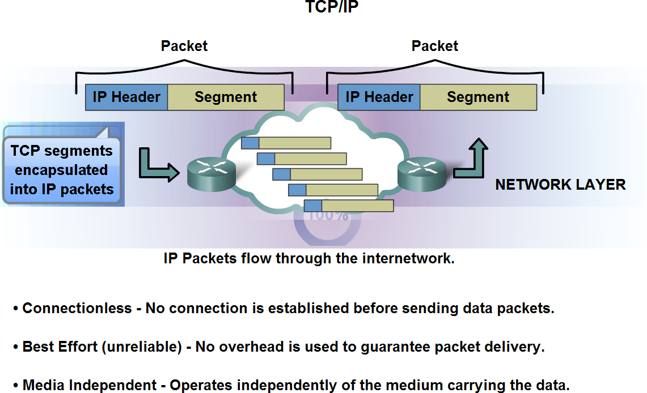
Network Layer Protocols and Internet Protocol (IP)

Slide 6
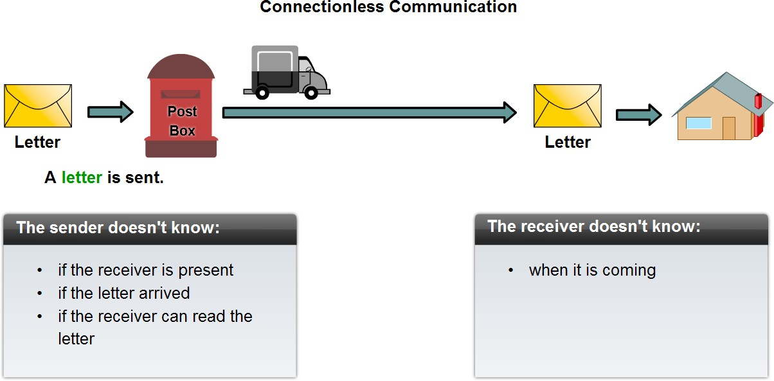
Network Layer Protocols and Internet Protocol (IP)
Connectionless communication

Slide 7
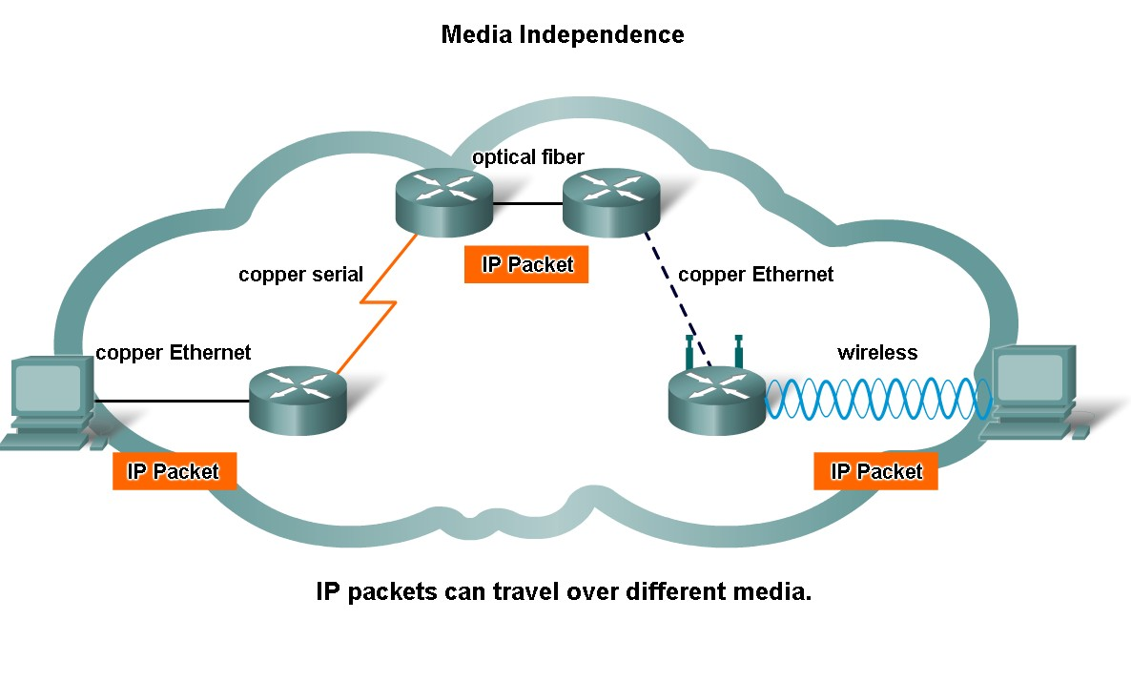
Network Layer Protocols and Internet Protocol (IP)
Media and link layer independent!

Slide 8
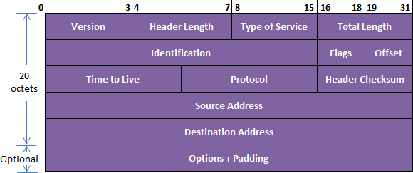
Internet Protocol (IP)
IP header → Total Length = 20 bytes + options

Slide 9
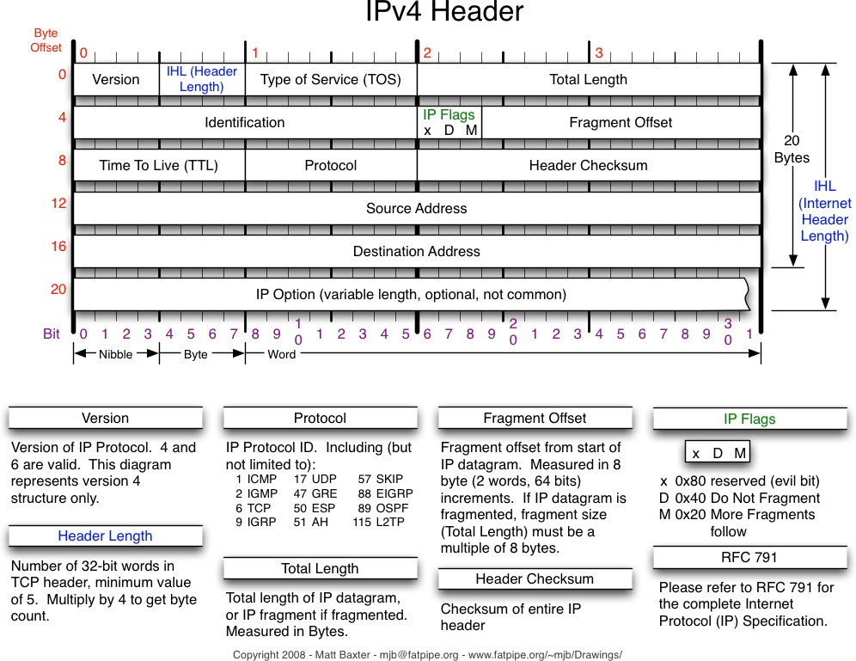
Internet Protocol (IP)

Slide 10
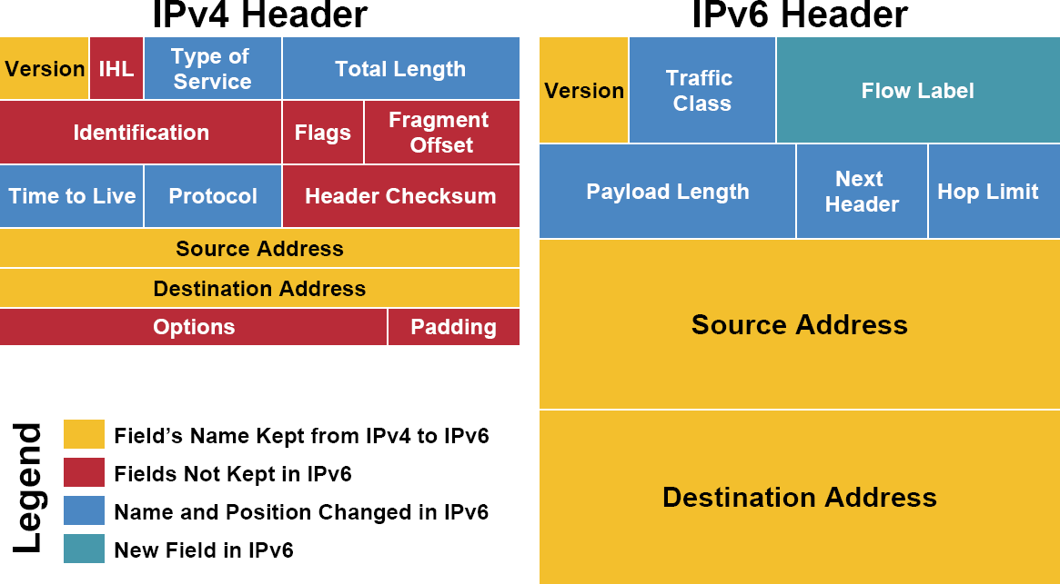
Internet Protocol (IP)

Slide 11
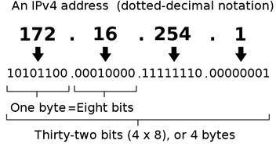
IP Address
Numerical label assigned to each device (e.g., computer, printer) participating in a computer network that uses the Internet Protocol for communication
Host or network interface identification and location addressing
Logical address
Can be changed
Written in decimal
32-bits for version 4 and 128-bits for version 6.
Unique addressing allows communication between end stations.
Path choice is based on destination address.

Slide 12
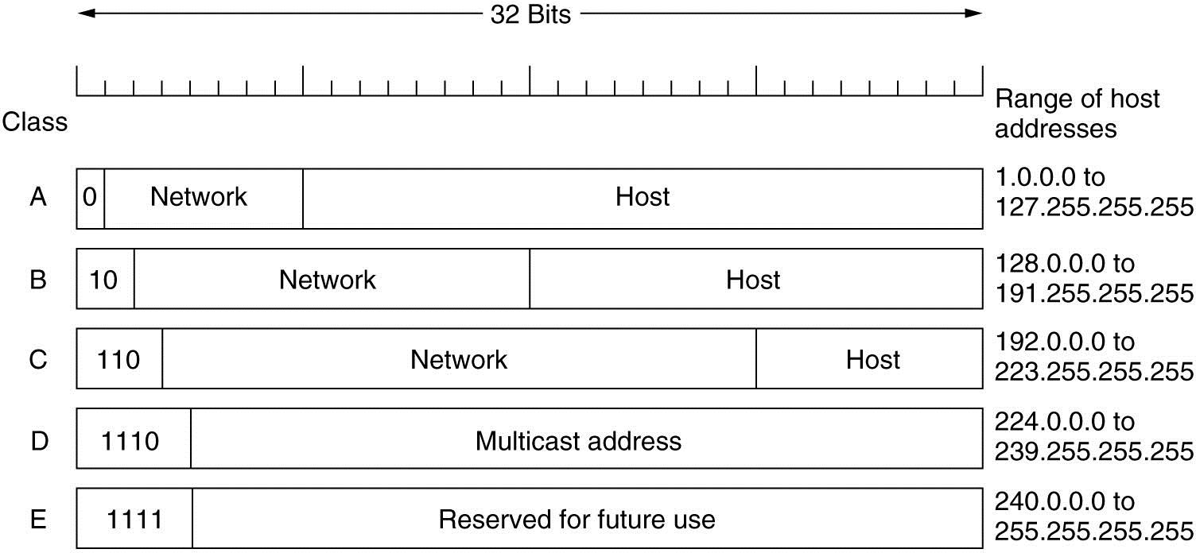
IP Address
IPv4 Classes

Slide 13
IPv4 Classes
Class A:
  Used for large networks.
  Format: Network.Host.Host.Host
o Netmask is 255.0.0.0 == /8
  Provides about 16.000.000 IP addresses.
  IP range for the first octet is (1-127).
  Note: 127 is not used since it is used for testing purposes.
Class B:
  Used for intermediate networks.
  Format: Network.Network.Host.Host
o Netmask is 255.255.0.0 == /16
  Provides about 64.000 IP addresses.
  IP range for the first octet is (128-191).

Slide 14
IPv4 Classes –
Class C:
  Used for small networks.
  Format: Network.Network.Network.Host
o Netmask is 255.255.255.0 == /24
  Provides 256 IP addresses (Only 254 can be used for hosts because two IP addresses are excluded as one is used as a network address and the other as a broadcast address)
  IP range for the first octet is (192-223).
Class D:
  Used for multicasting purposes.
  The multicast addresses are in the range 224.0.0.0 through 239.255.255.255.
  Multicasting: sending data to hosts that belong to a multicast group.
Class E:
o Used for research purposes & future use.
o Class E range is 240.0.0.0 through 255.255.255.255

Slide 15
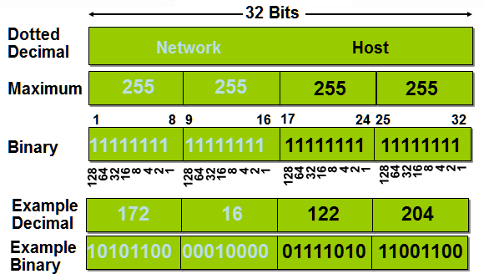
IP Addressing

Slide 16
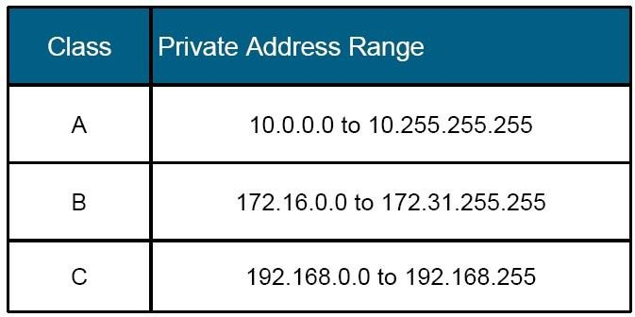
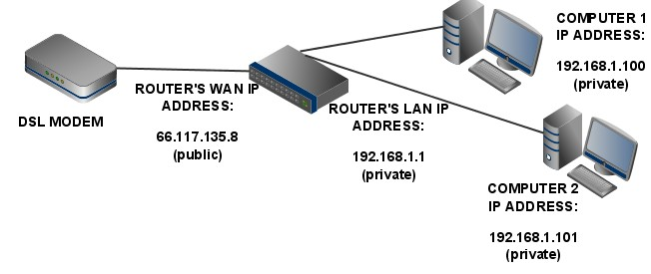
IP Address
Private IP address range

Slide 17
Layer 4
Transport Layer

Slide 18
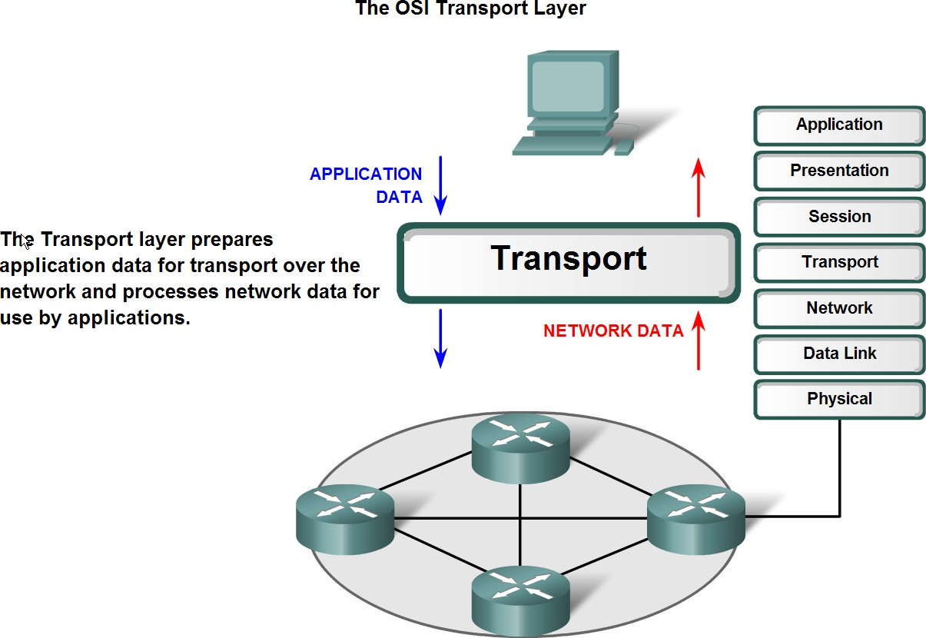
Transport Layer Role and Services

Slide 19
Transport Layer Role and Services
This layer is responsible for end-to-end delivers of messages
between the networked hosts (end-to-end connections)
It is responsible for source process to destination process delivery of entire message.
Functions:
oSegmentation and Reassembly: Divide the message received from
Session layer into Segments and number them to make a sequence for reassembly at the receiving side.
oService point addressing: Transport layer makes sure that the message is delivered to the correct process on destination machine.
oError Control: Make sure that the entire message arrives without errors else retransmit.
oFlow Control: Transport layer makes sure that the sender and the receiver communicate at a rate they both can handle.
Transport layer protocols:
  TCP → Transmission Control Protocol
  UDP → User Datagram Protocol

Slide 20
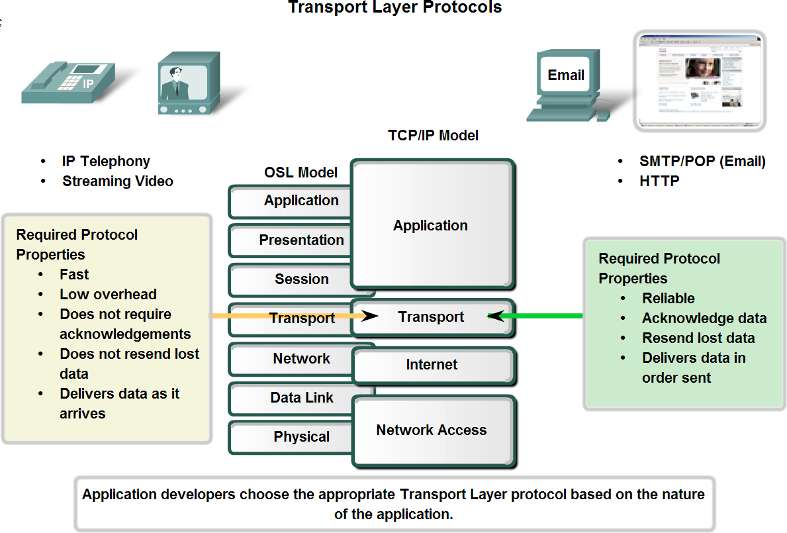
Transport Layer Role and Services
Transport layer provides two types of services:
  Connection Oriented Transmission: In this type of transmission the receiving device sends an acknowledgment back to the source after a packet or group of packet is received → TCP (Right)
  Connectionless Transmission: In this type of transmission the receiver does not acknowledge receipt of a packet → UDP (Left)

Slide 21
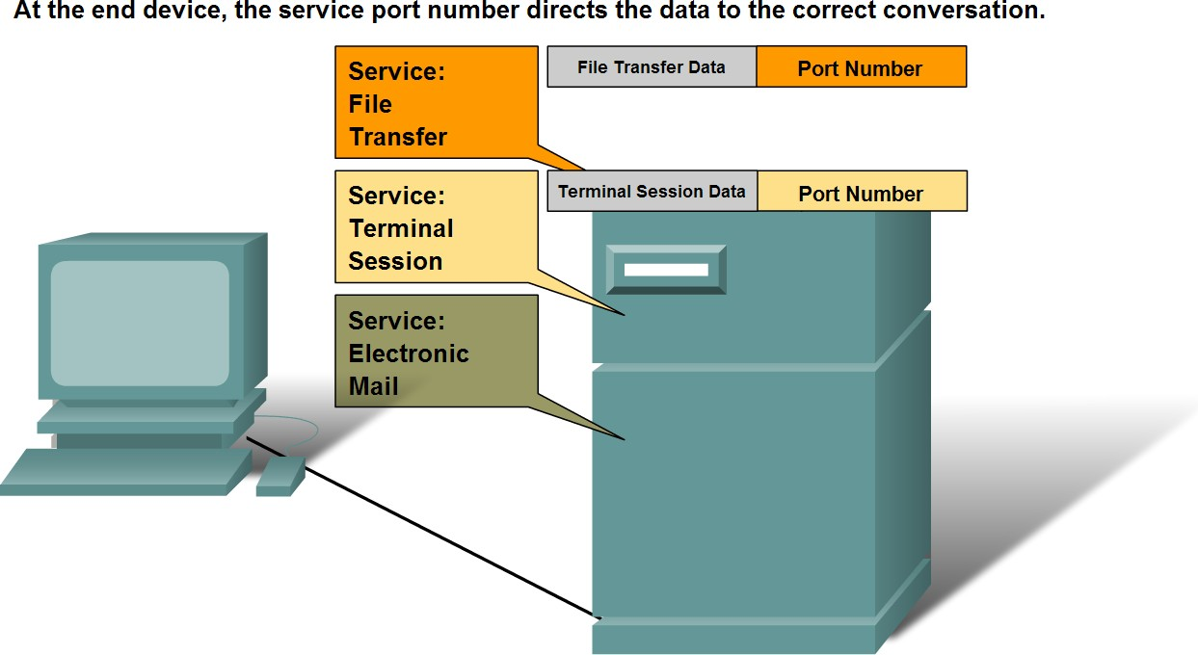
Transport Layer Role and Services
Why do we need TCP/UDP ports ?

Slide 22
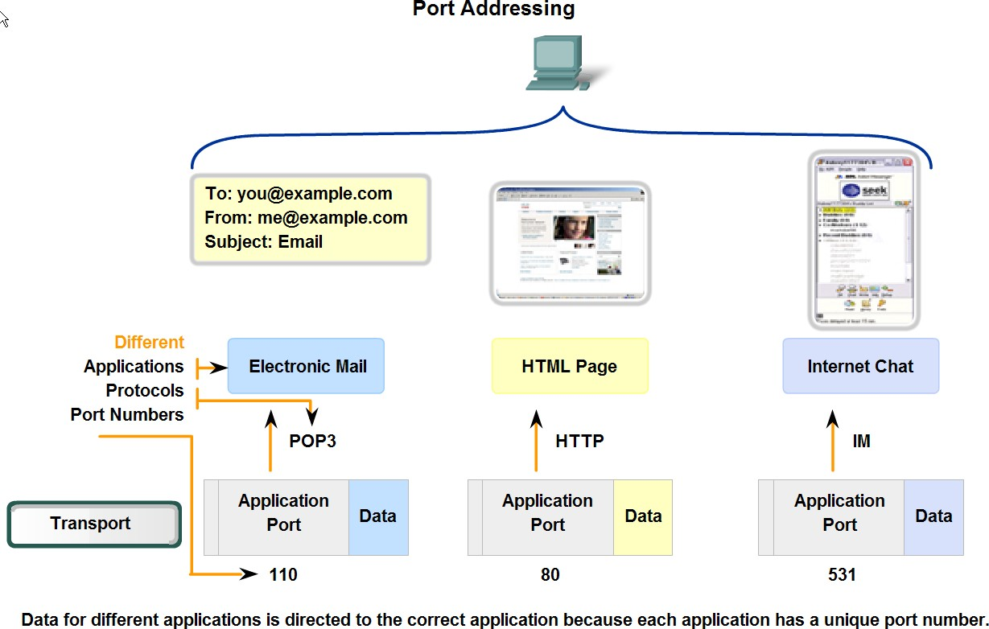
Transport Layer Role and Services
Example of ports usage

Slide 23
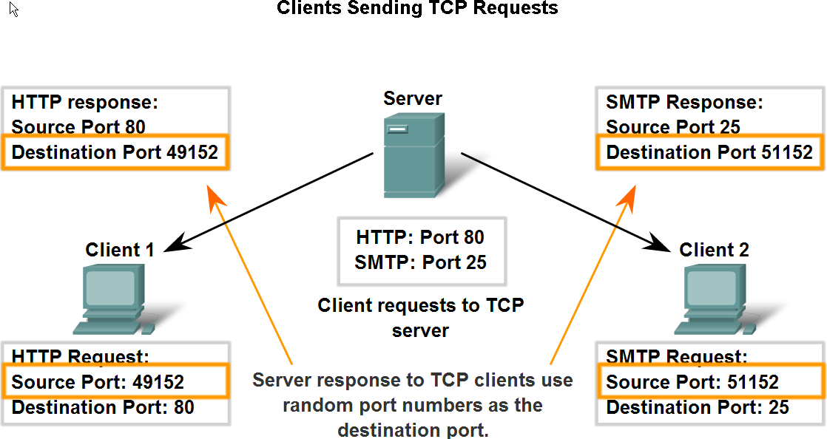
Transport Layer Role and Services

Slide 24
Transport Layer - Segmentation
Segmentation and Reassembly: Divide the message received from Session layer into Segments and number them to make a sequence for reassembly at the receiving side.
Reasons for data segmentation:
  Limited bandwidth: send segments instead of whole data.
  Error correction: correct corrupted segments instead of correcting whole data.
  Multiple path: send a segment using a path and another segment using another path, instead of sending the whole data using one path.
The maximum transmission unit (MTU): is the size of the segment. (64 – 1500 byte)

Slide 25
Transport Layer – TCP & UDP
TCP | UDP
Sequenced (ordered) → rearranges data packets in the order specified | Un-sequenced (Unordered) → All packets are independent of each other
Reliable → sequence numbers, acknowledgments and 3 way handshake | Unreliable → best effort only, no concept of acknowledgments, retransmission or timeout
Connection Oriented → 3 way handshake | Connectionless → No handshake
Streaming Oriented → Data transmitted as virtual stream of bytes | Message Oriented → Data transmitted as individual data packets called datagram
Heavy overhead → Header size is 20 bytes | Light overhead → Header size is 8 bytes
Lower speed | Higher speed
Checksum for error checking → error-free | Checksum for error checking, but no error recovery
Flow Control, Windowing & Congestion Control | No Flow Control, Windowing or Congestion Control
Suited for applications that require high reliability, and transmission time is relatively less critical | Suitable for applications that need fast, efficient transmission such as games, audio & video. UDP’s stateless nature is also useful for servers that answer small queries from huge numbers of clients
HTTP, HTTPs, FTP, SMTP, TELNET | DNS, TFTP, SNMP, RIP, RTP, DHCP

Slide 26
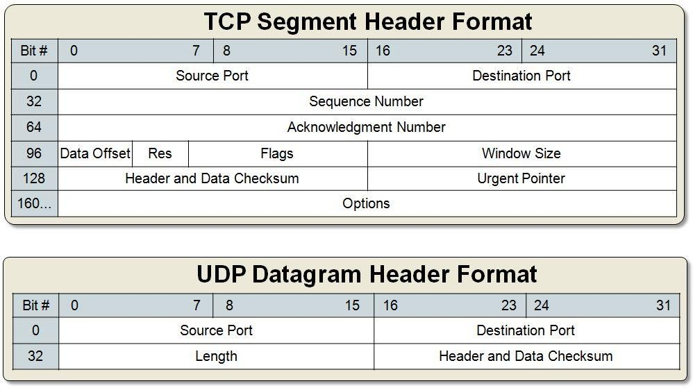
Transport Layer – TCP & UDP
TCP & UDP headers format:

Slide 27
Transport Layer – TCP
TCP Flags (Control bits):
  CWR – Congestion Window Reduced (CWR) flag is set by the sending host to indicate that it received a TCP segment with the ECE flag set
  ECE (ECN-Echo) – indicate that the TCP peer is ECN (Explicit
Congestion Notification) capable during 3-way
  URG – indicates that the URGent pointer field is significant
  ACK – indicates that the ACKnowledgment field is significant
  PSH – Push function
  RST – Reset the connection (Seen on rejected connections)
  SYN – Synchronize sequence numbers (Seen on new connections)
  FIN – No more data from sender (Seen after a connection is closed)

Slide 28
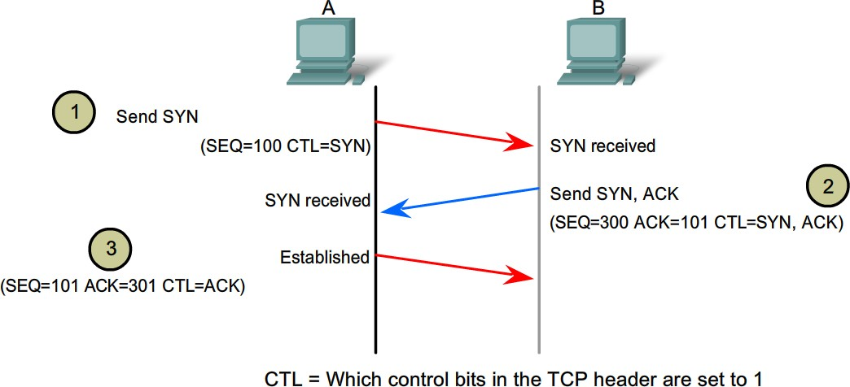
Transport Layer – TCP
TCP Connection Establishment → 3-Way Handshake SYN → SYN/ACK → ACK
TCP uses a three-way handshake to establish a reliable connection.
The connection is full duplex, and both sides synchronize (SYN) and acknowledge (ACK) each other.

Slide 29
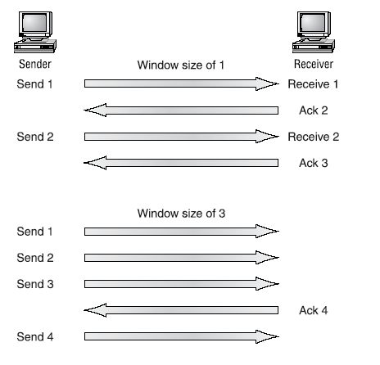
Transport Layer – TCP
TCP Windowing → quantity of data segments in bytes that a machine can transmit/send on the network without receiving an acknowledgement

Slide 30
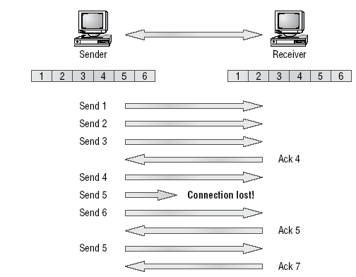
Transport Layer – TCP
TCP Reliable Delivery → Retransmission

Slide 31
Transport Layer – TCP
TCP Flow Control
  Another function of the transport layer is to provide optional flow control.
  Flow control is used to ensure that networking devices don’t send too much information to the destination, overflowing its receiving buffer space, and causing it to drop the sent information
  The purpose of flow control is to ensure the destination doesn't get overrun by too much information sent by the source
TCP Flow Control → Sliding Window
  TCP allows data burst for maximizing throughput.
  The receiver advertises the size of receive buffer.
  The sequence and acknowledge numbers are per byte (not per segment/packet).
  The receiver‘s ack number is the number of the next byte it expects; this implicitly acknowledges all previously received bytes. Thus acks are cumulative, Ack=X acknowledges all bytes up to and including X-1.

Slide 32
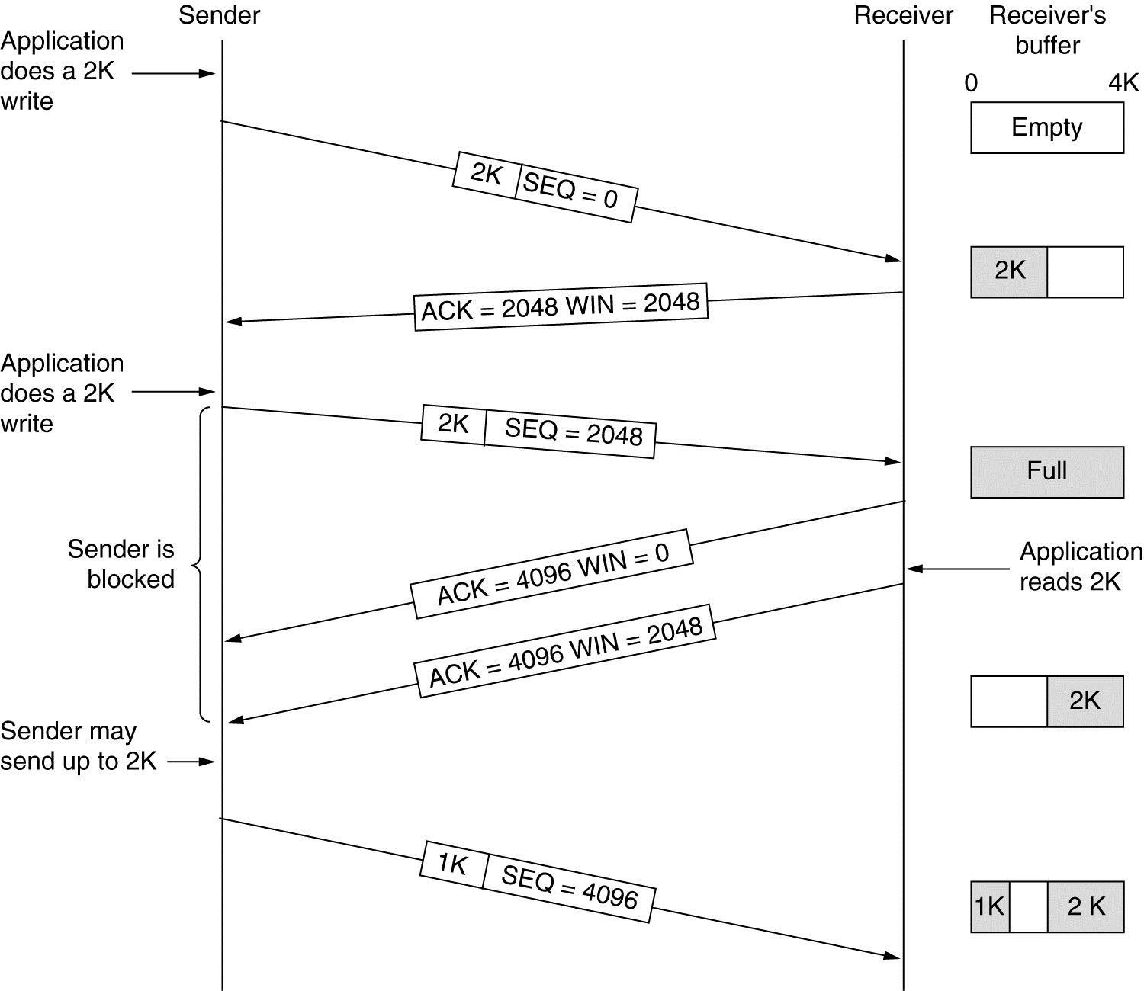
Transport Layer – TCP
TCP Flow Control → Sliding Windows

Slide 33
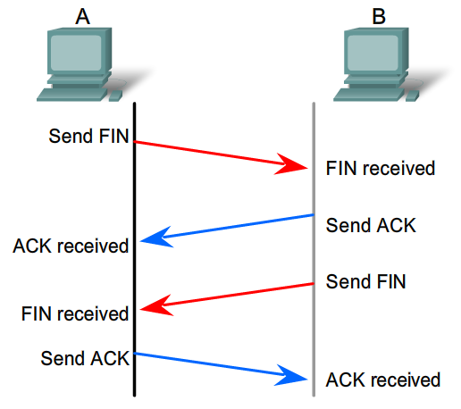
Transport Layer – TCP
TCP Connection Termination → 4-Way Handshake FIN → ACK, FIN → ACK

Slide 34
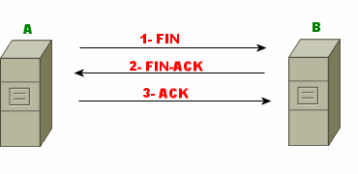
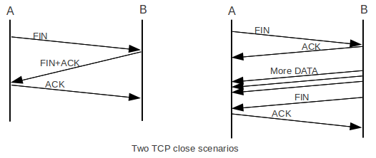
Transport Layer – TCP
TCP Connection Termination → 3 Way Handshake FIN → FIN/ACK → ACK

Slide 35
Transport Layer – TCP
TCP Connection Reset → RST
Some TCP RST scenarios:
  TCP Reset due to no response:
    No response for SYN when establishing connection, retransmits SYN 2 times (default)
    Network frame is sent six times (this would be the original frame plus five (default) retransmits of the frame) without a response → for Established connection
  Receipt of any TCP segment from any device with which the device receiving the segment does not currently have a connection (other than a SYN requesting a new connection.) → Spoofing
  Receipt of a message with an invalid or incorrect Sequence Number or Acknowledgment Number field, indicating the message may belong to a prior connection or is spurious in some other way.
  ACK/RST → Receiver cannot accept the connection (Rejection)
    Receipt of a SYN message on a port where there is no process listening for connections.
    There is some reason that the server node cannot complete the connection on that port. For example, the server is out of resources and so cannot allocate the needed resources to allow the connection.
  Application Reset → user is suddenly kicked out of an application

Slide 36
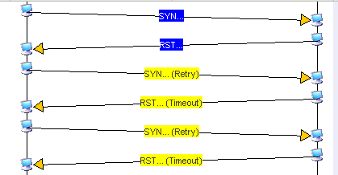
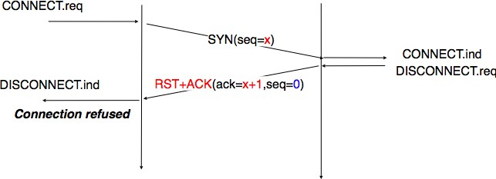
Transport Layer – TCP
TCP Connection Reset → Rejection

Slide 37
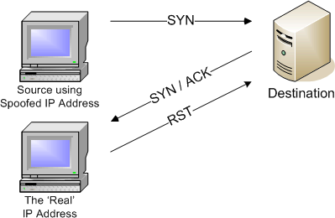
Transport Layer – TCP
TCP Connection Reset → Spoofing

Slide 38
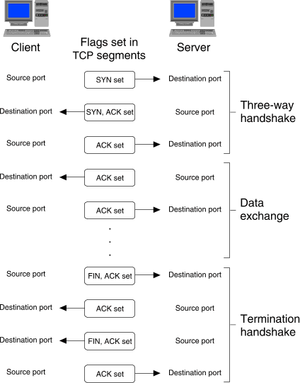
Transport Layer – TCP

Slide 39
Layer 5
Session Layer
39

Slide 40
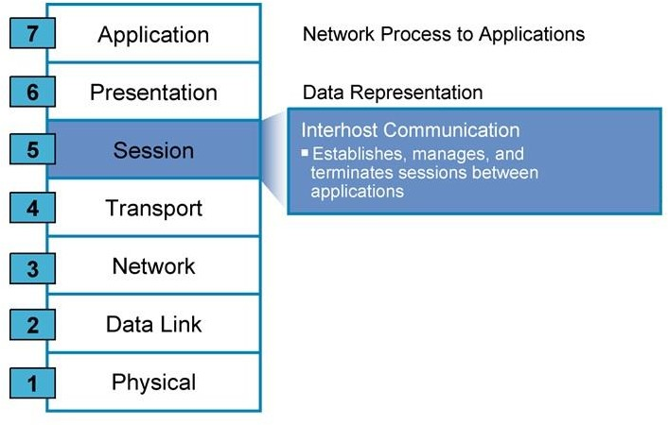
Session Layer – Interhost communication

Slide 41
Session Layer – Interhost communication
Session Layer is responsible for:
oInter-host communication (sessions/sockets between hosts)
oCreates virtual circuit (logical connection)
oSession establishment oManaging the session oTerminating the session
oProvides dialogue control between devices (Coordinating)
oAuthentication & Authorization
Common Protocols: SQL, ASP, NFS, RPC, L2TP, PPTP, RTCP, PAP, NetBIOS, SCP, SOCKS
PDU is Formatted DATA

Slide 42
Layer 6
Presentation Layer

Slide 43
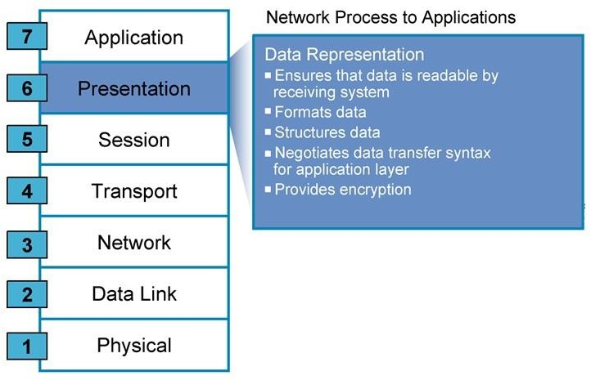
Presentation Layer – Data Representation

Slide 44
Presentation Layer – Data Representation
Presentation Layer is responsible for:
oData translation: data must be readable by application
layer on both ends.
oData formatting: files extensions. oData compression and decompression. oData encoding and decoding.
oData encryption and decryption
Common Protocols: JPEG, MIDI, MPEG, PICT, any file extension.
PDU is Formatted DATA

Slide 45
Layer 7
Application Layer

Slide 46
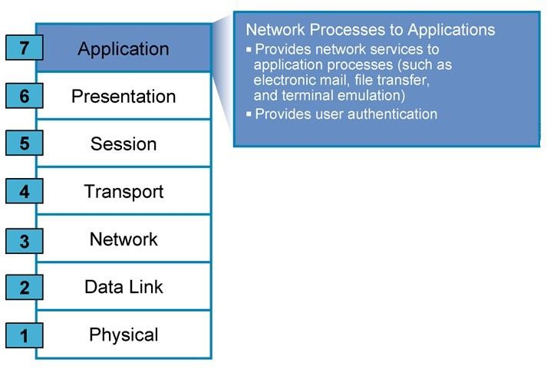
Applications – The Interface Between Human and Data Networks

Slide 47
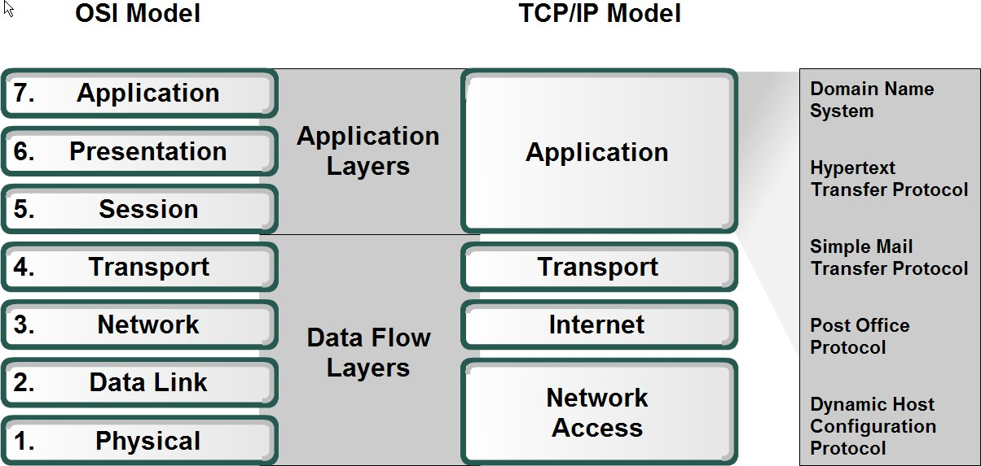
Applications – The Interface Between Human and Data Networks

Slide 48
Applications – The Interface Between Human and Data Networks
Application Layer:
  It is the interface between the user and the network.
  It uses the appropriate protocol according to the process being done.
Common Protocols:
HTTP: web browsing.
FTP: transferring files, upload and download.
SMTP: sending emails.
POP3: Receiving emails.
DNS: Name resolution, resolves names into IP addresses and versa.
Telnet: Remote access.
vice
PDU is User DATA

Slide 49
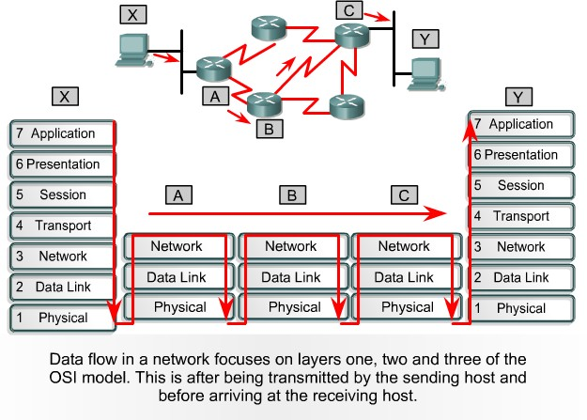
Data Flow Through a Network

Slide 50
IP
Addressing
IP Subnetting

Slide 51
IP Subnetting
Subnetting is logically dividing the network to sub networks
by increasing the 1’s used in the subnet mask
The main idea of subnetting is saving IP addresses and use them according to hosts number that will be used in the network.
Advantages
  Saving IPs
  Can divide network in smaller parts
  Restrict Broadcast traffic
  Security
  Simplified Administration

Slide 52
IP Subnetting
Example:
  192.168.10.0/24: provides 254 IP addresses.
  In your network you have 20 hosts.
  Without subnetting you will waste 234 IP addresses (254 – 20).
Why wasting ??
  The last octet of 192.168.10.0/24 consists of 8 bits.
  We have 20 hosts so we need to use only the last 5 bits of that octet since ((2⁵) – 2) = 30 which covers the 20 hosts.
  The remaining 3 bits will be added to the network part so that we have a /27 address.

Slide 53
IP Subnetting – Formula
Number of subnets – 2^{x}-2
Where X = number of bits borrowed
Number of hosts – 2^{y}-2
Where y = number of 0’s
Block Size = Total number of addresses
Block Size = 256-Mask

Slide 54
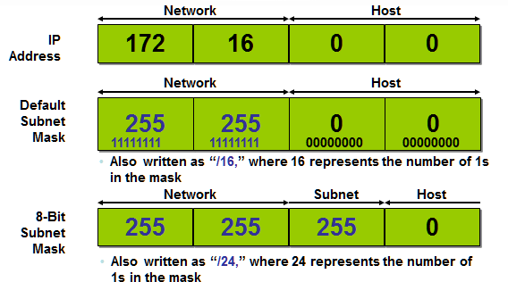
IP Subnetting – Subnet Mask

Slide 55
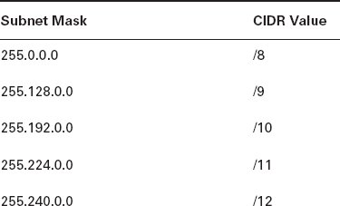
Subnet Masks & CIDR Values
CIDR (Classless Inter-Domain Routing) also known as supernetting -- is a method of assigning Internet Protocol (IP) addresses that improves the efficiency of address distribution and replaces the previous system based on Class A, Class B and Class C networks.

Slide 56
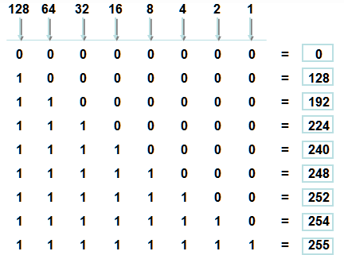
IP Subnetting – Subnet Mask
Possible subnet mask values
Mask | CIDR
0 | /24
128 | /25
192 | /26
224 | /27
240 | /28
248 | /29
252 | /30

Slide 57
IP Subnetting – Example
Question: What are the subnet and broadcast addresses for the subnet which the IP 172.16.10.10 255.255.255.192 is a member of?
Answer:
  Find the block size
256 – 192 (last octet of the subnet mask) = 64. Block size = 64.
  Subnets are : 0, 64, 128, etc.
The last octet of the IP is 10 and 10 is in the 0 subnet.
  Then the subnet address is 172.16.10.0/26
  The broadcast address is always (the next subnet – 1)
Current subnet = 0, next subnet = 64 broadcast address = 172.16.10.63

Slide 58
IP Subnetting – Example
Question: What are the subnet and broadcast addresses for the subnet which the IP 172.16.88.20 255.255.240.0 is a member of?
Answer:
  256 – 240 = 16, so the block size is 16.0.
o Valid subnets are 16.0, 32.0, 48.0, …, 80.0, 96.0, etc.
  88.20 is within 80.0 subnet, so the subnet address is 172.16.80.0/20
  Next subnet is 172.16.96.0, (broadcast address = next subnet – 1) =
172.16.95.255

Slide 59
Q&A

